Slide 1
Anomaly Detection in Graphs Past, Present and Future
Leman Akoglu CMU
Mary McGlohon CMU*
Christos Faloutsos CMU
* Now at Google; work done at CMU

Slide 2

Roadmap
Introduction – Motivation
OddBall : spotting unusual nodes
Last 10 years
Graph Anomalies
Graph Representation
Future

Slide 3
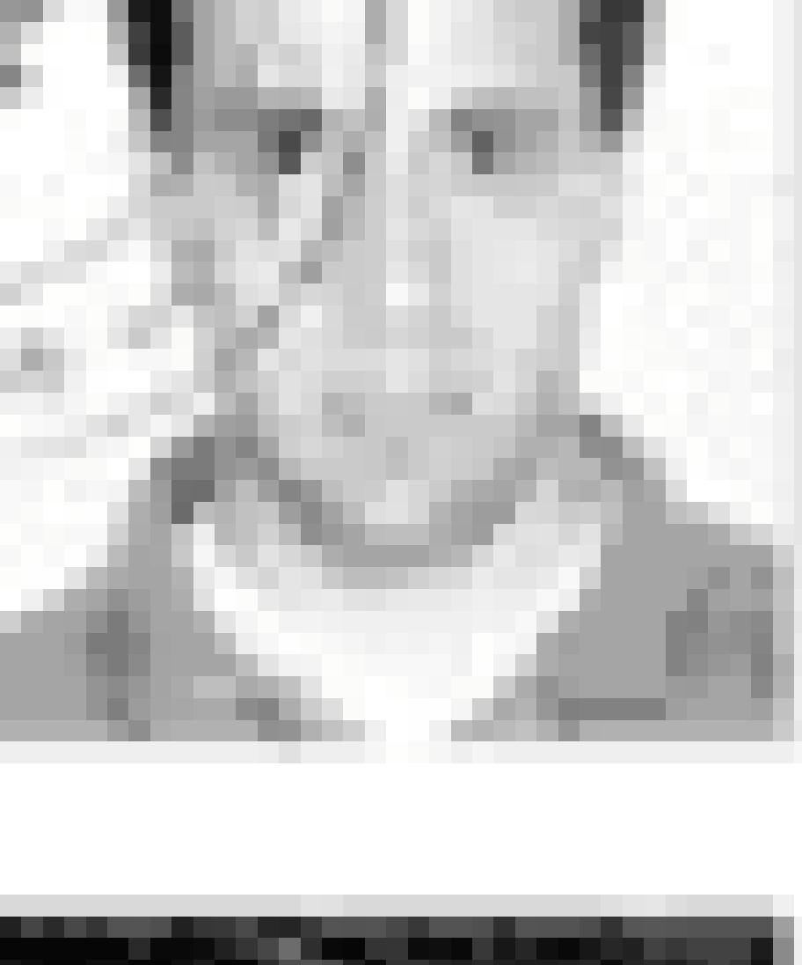
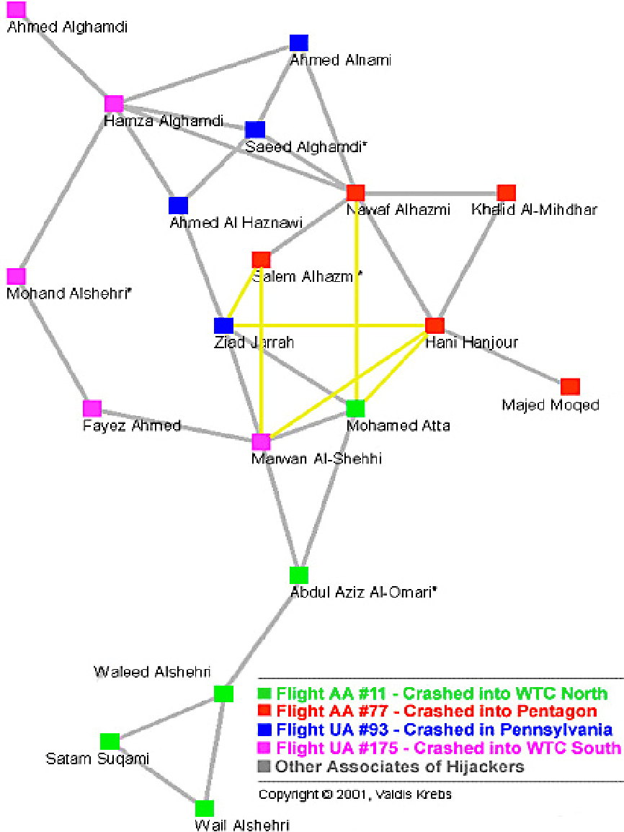
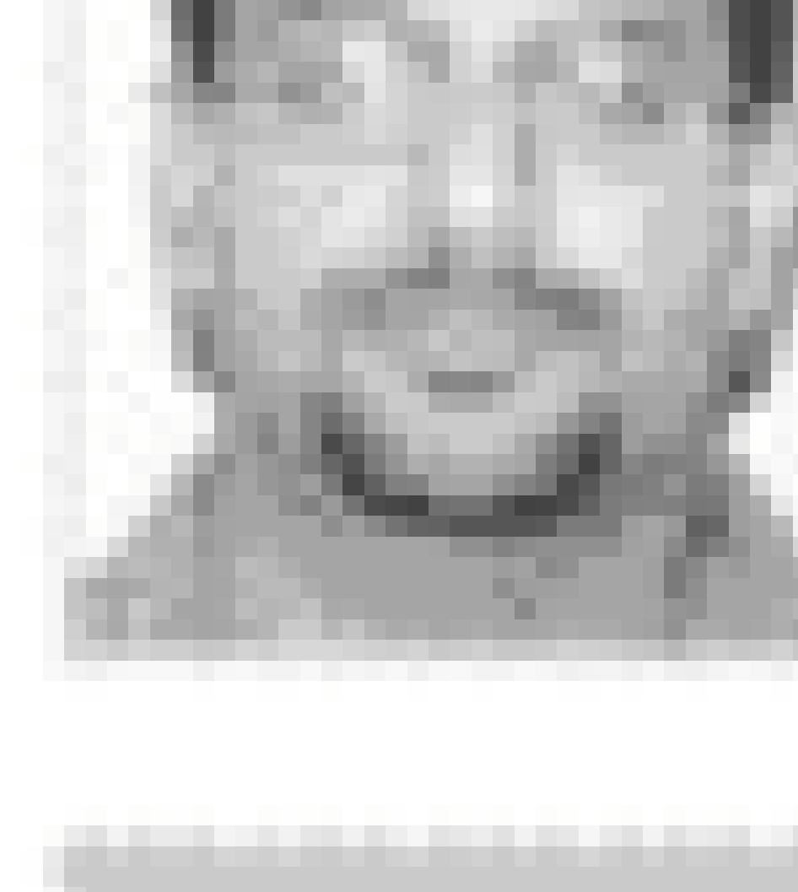

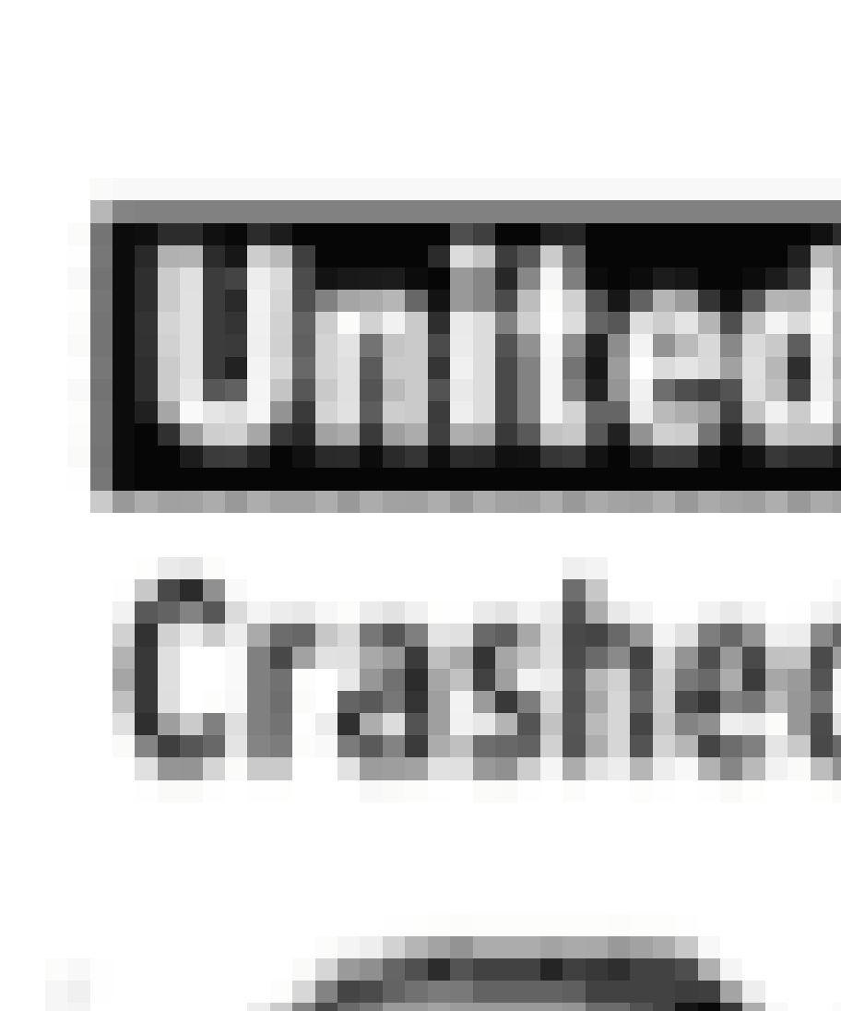

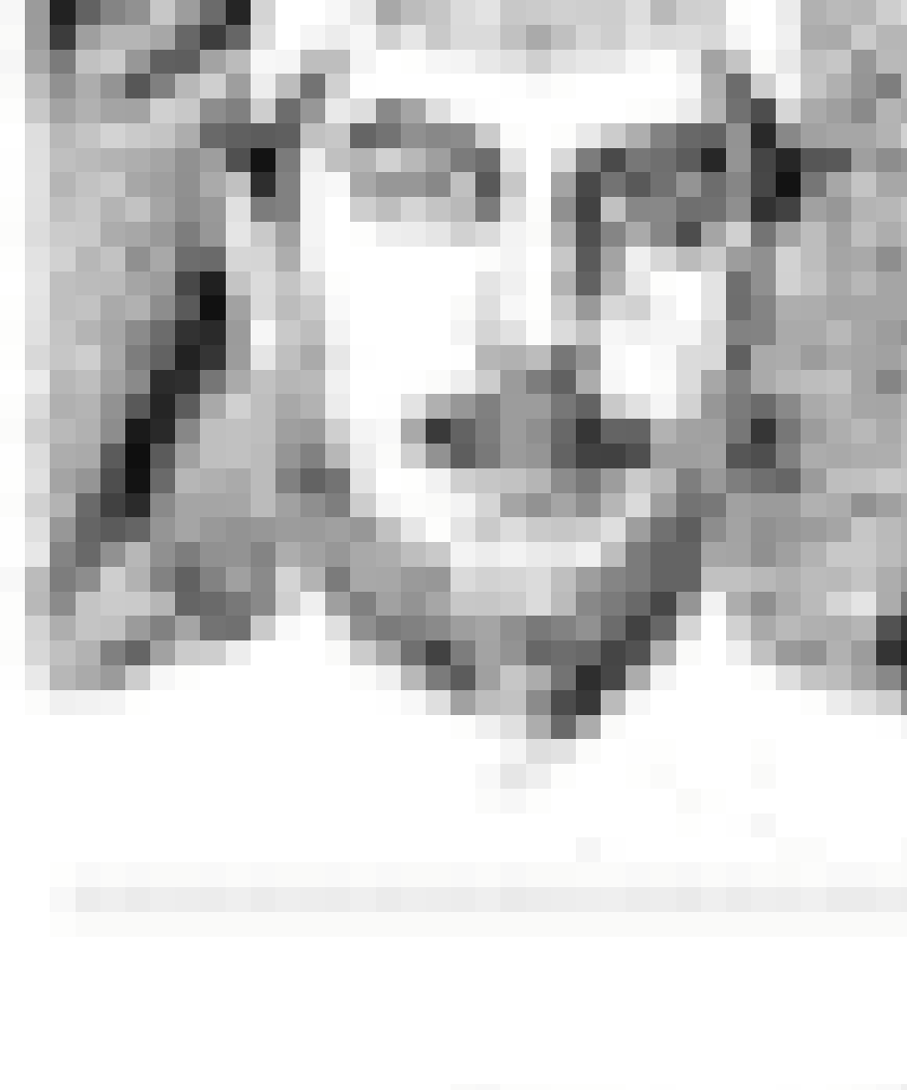

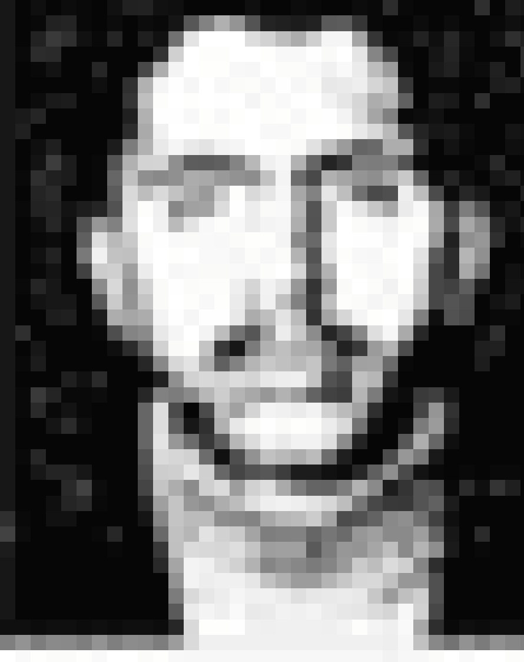
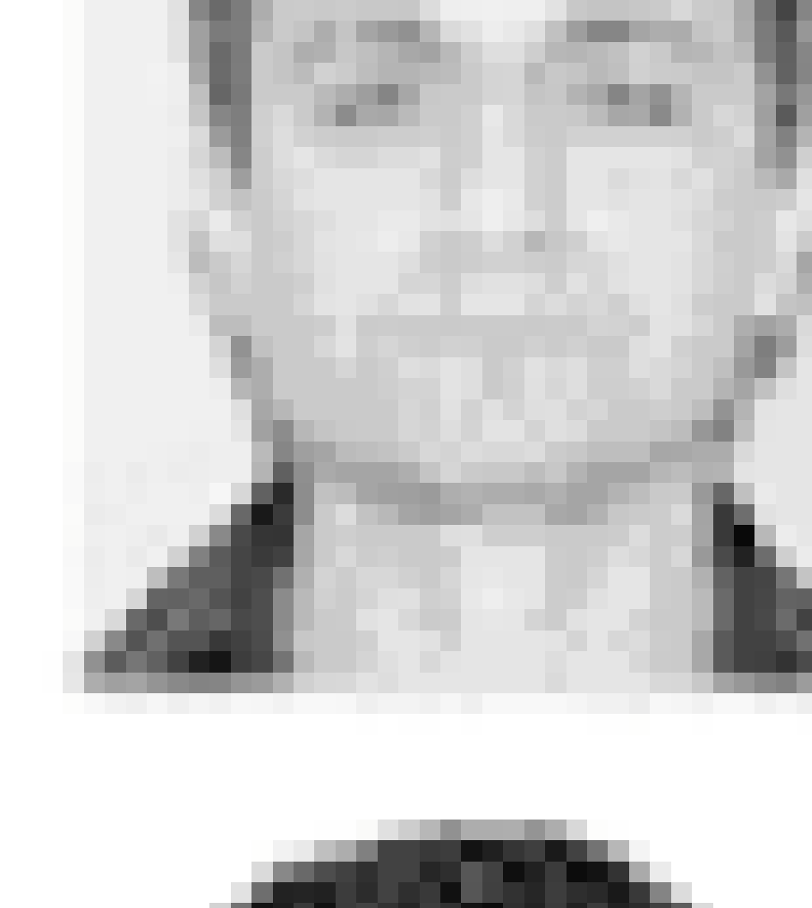
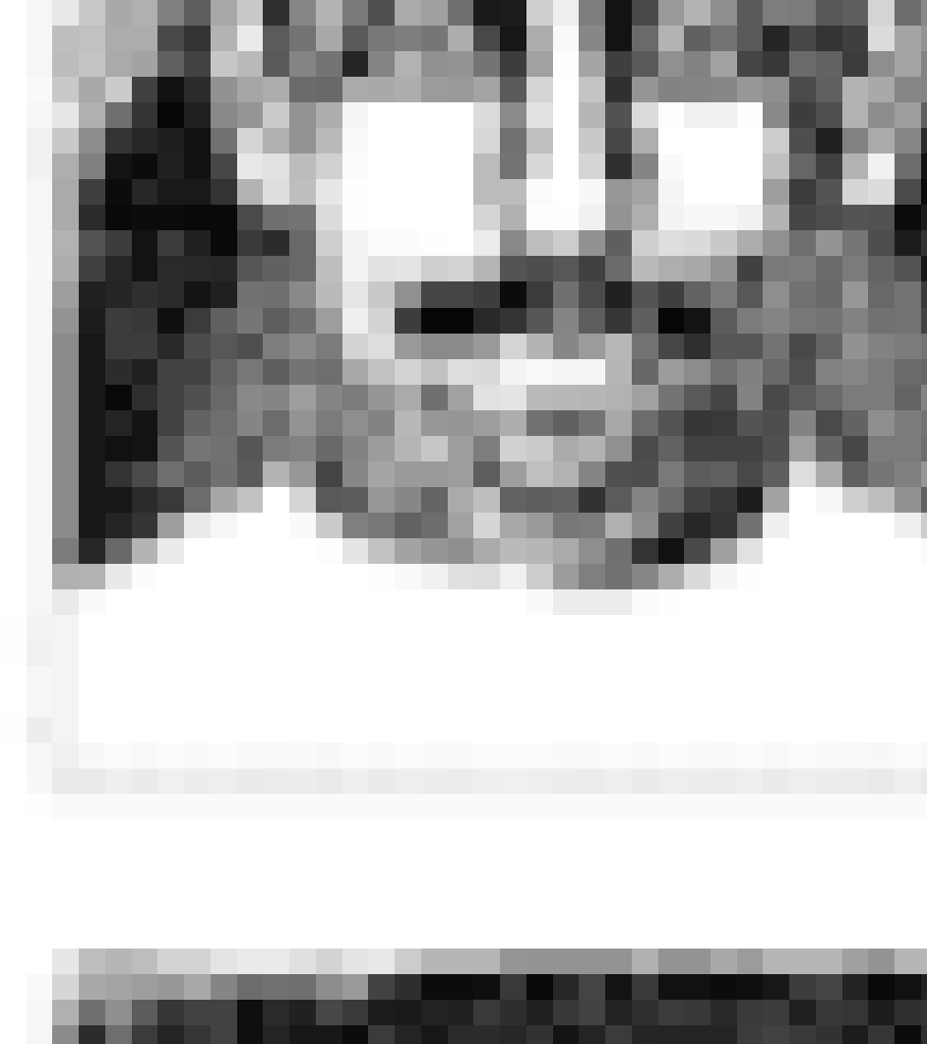

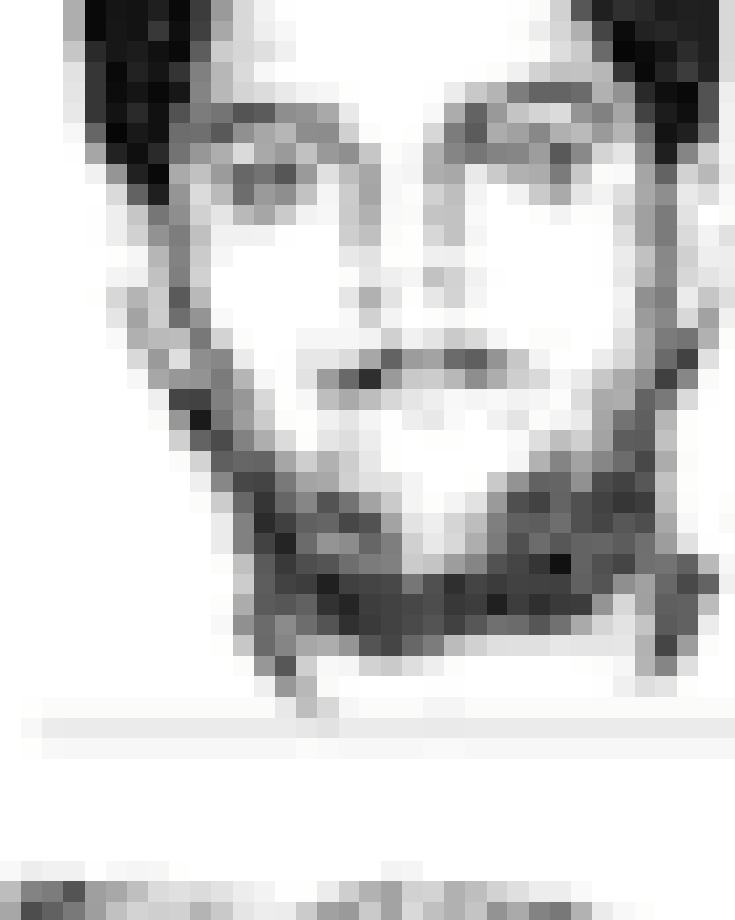
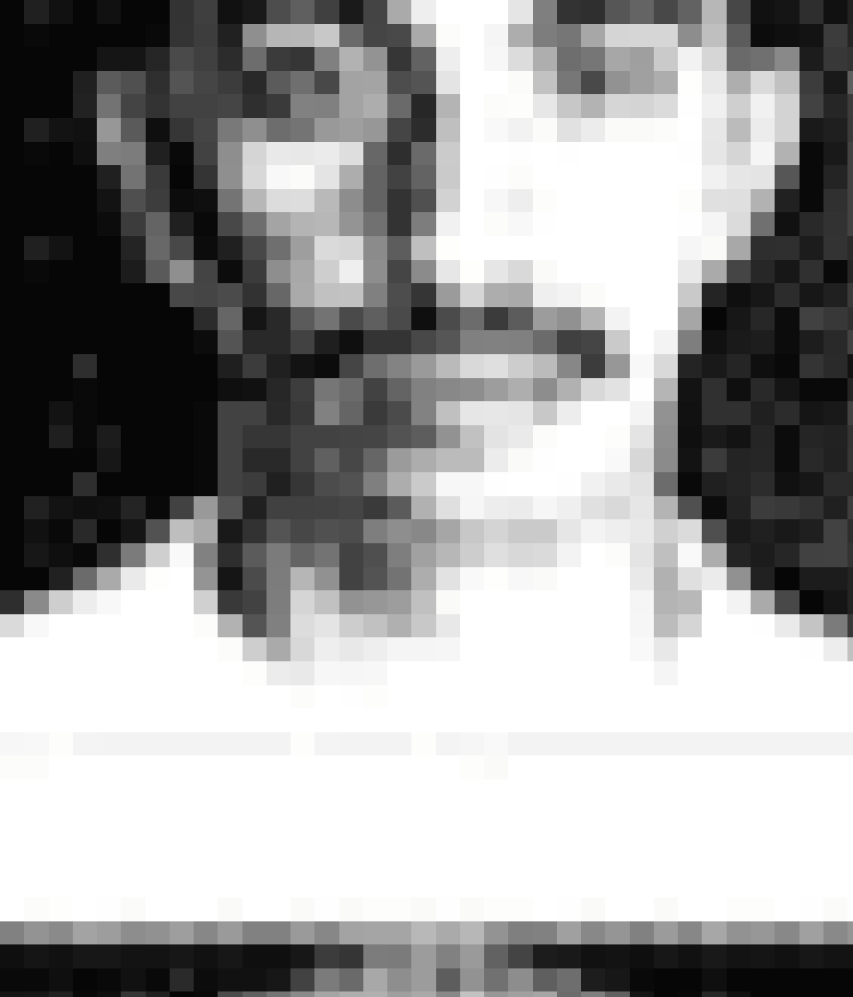
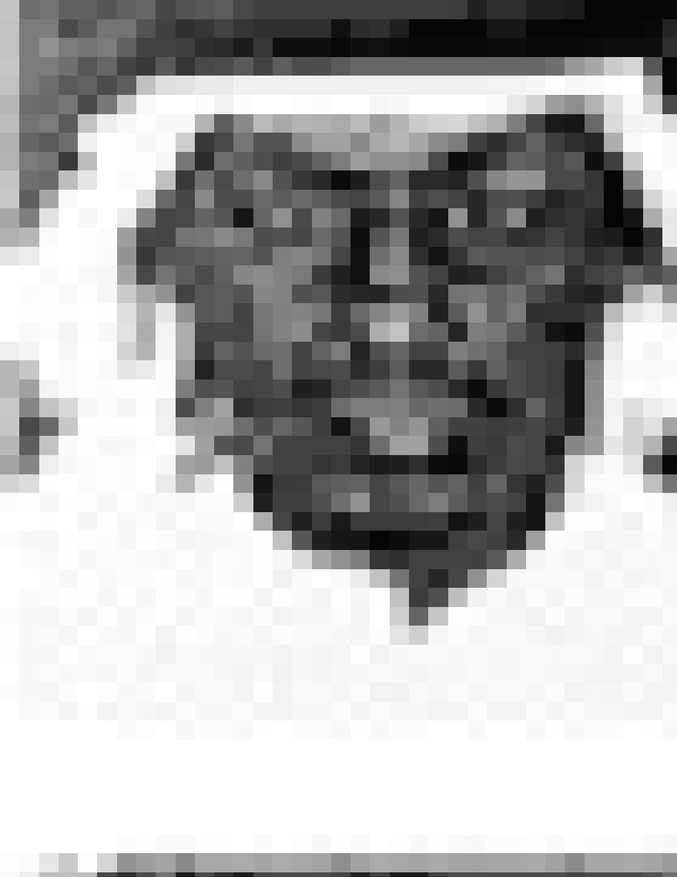
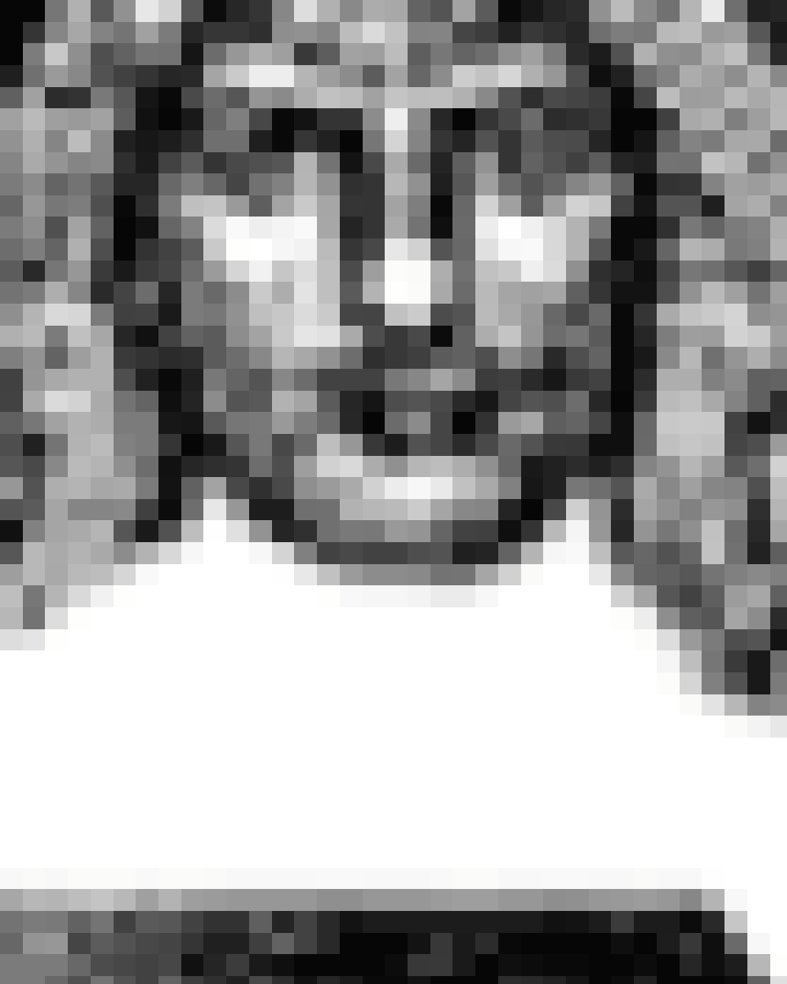

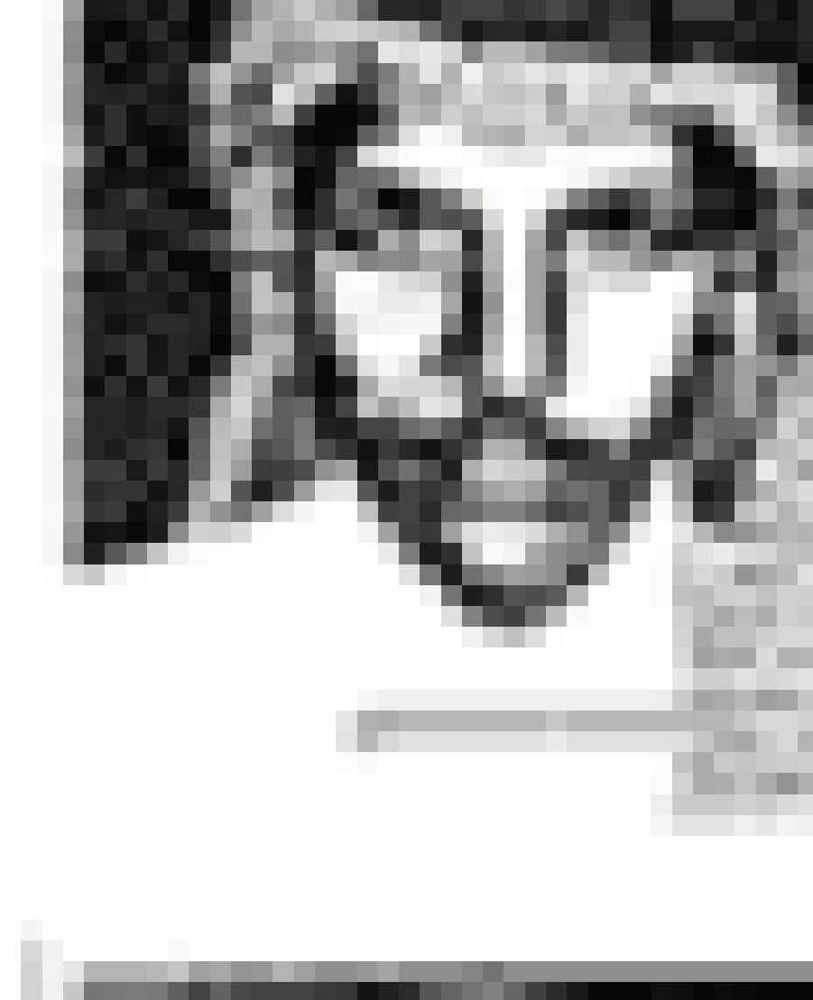
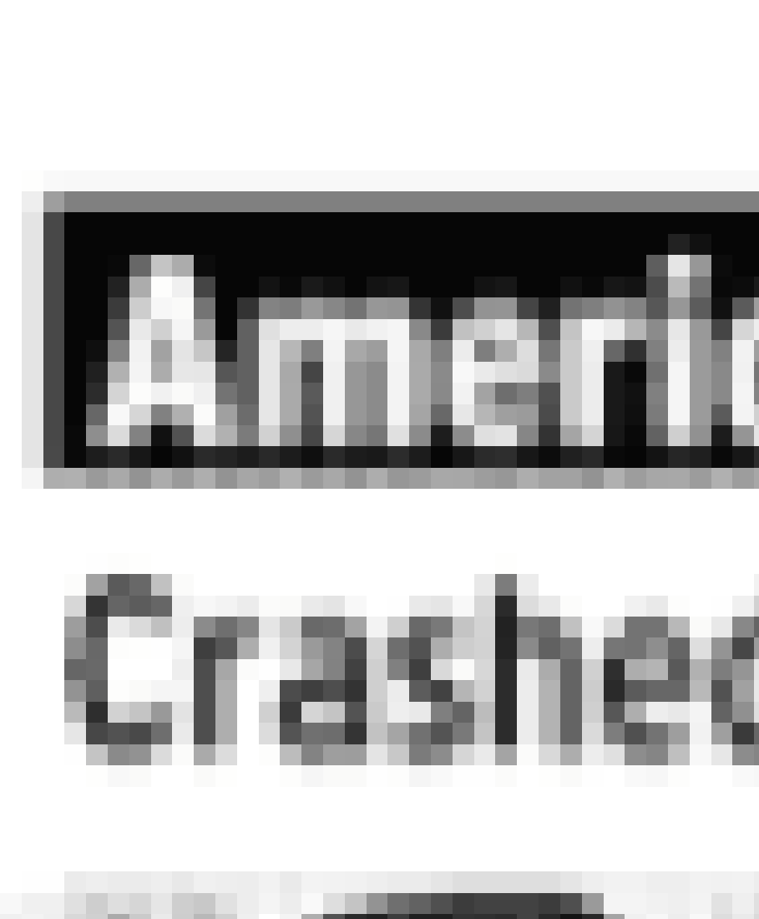
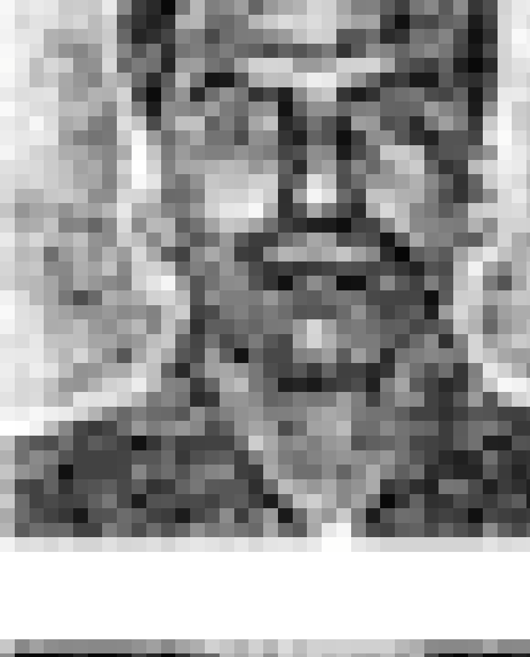
Graph Anomalies - I
Finding unusual nodes/edges,
e.g. telemarketers, bots
or subgraphs
e.g. link farms, terrorist groups
in a single graph
Notes:
What is this area about

Slide 4
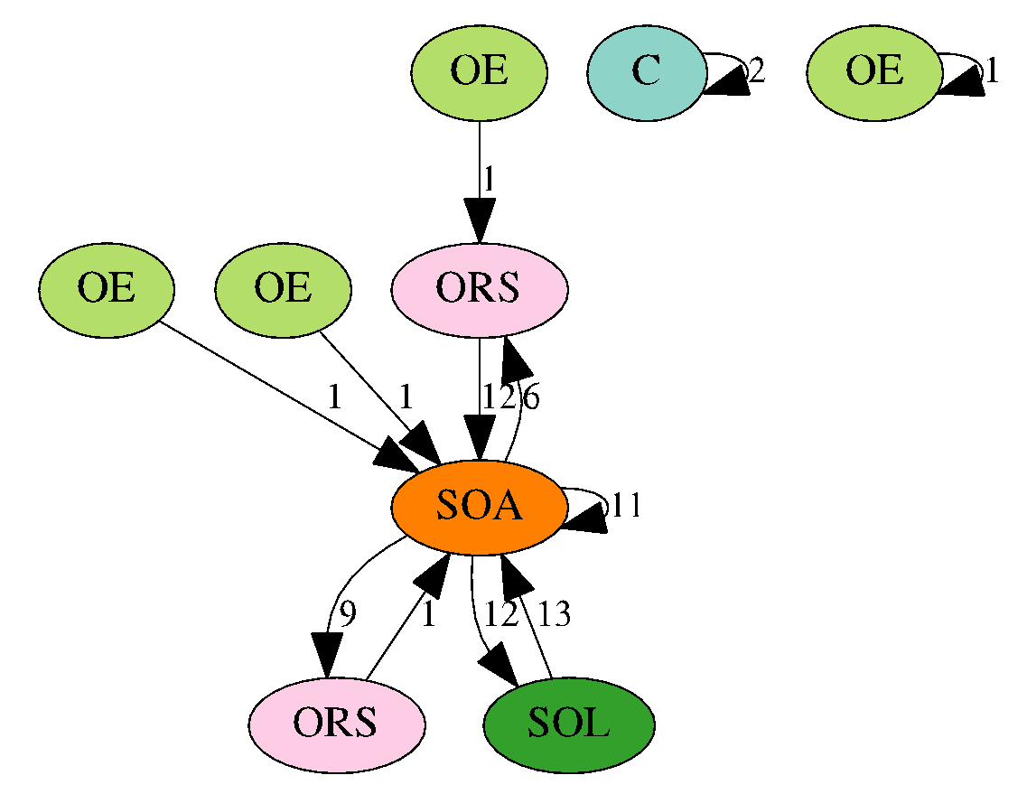
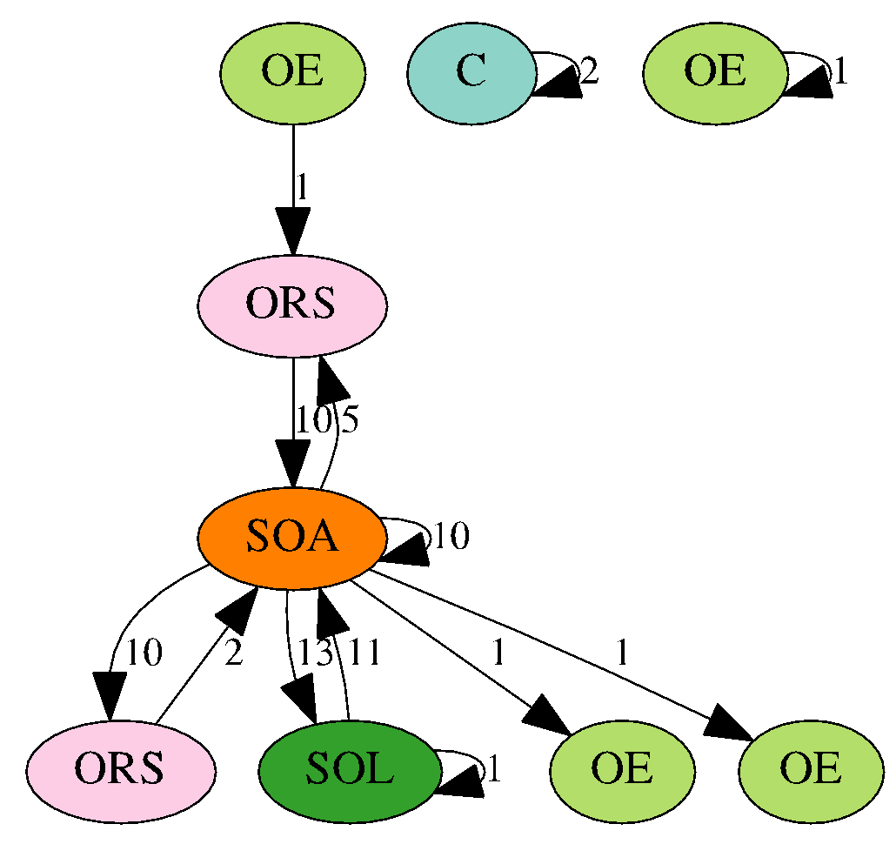
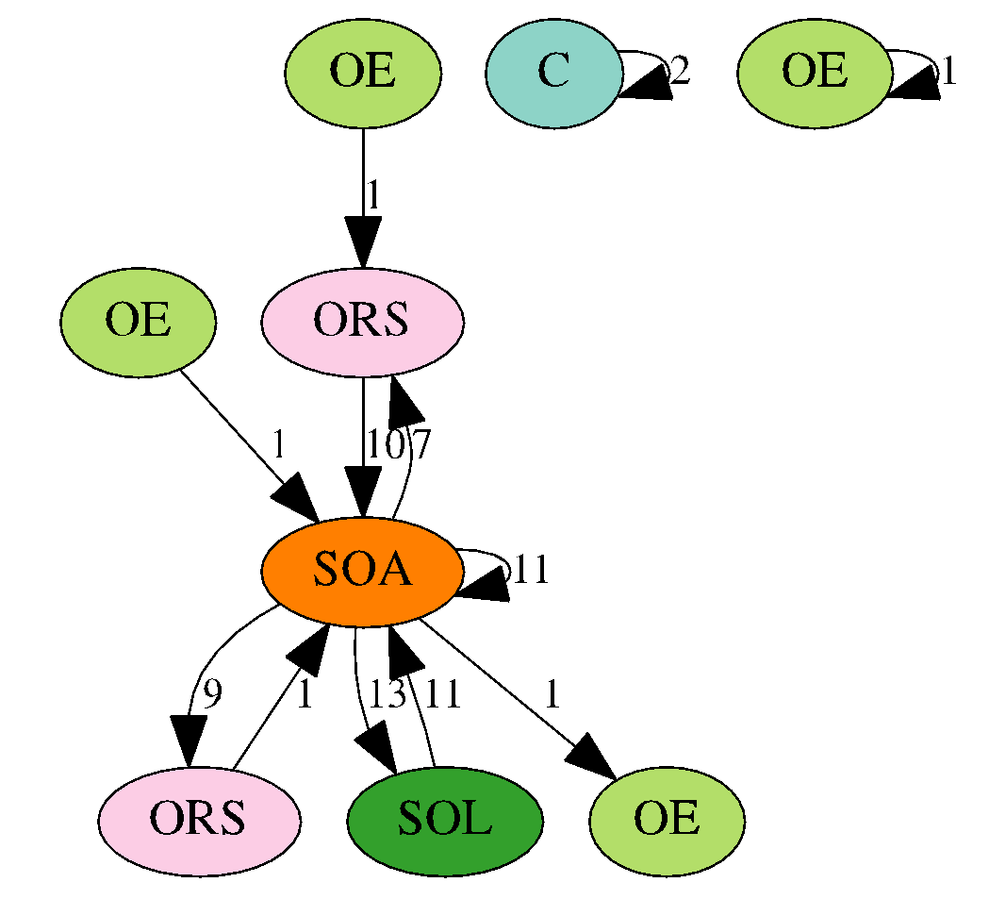
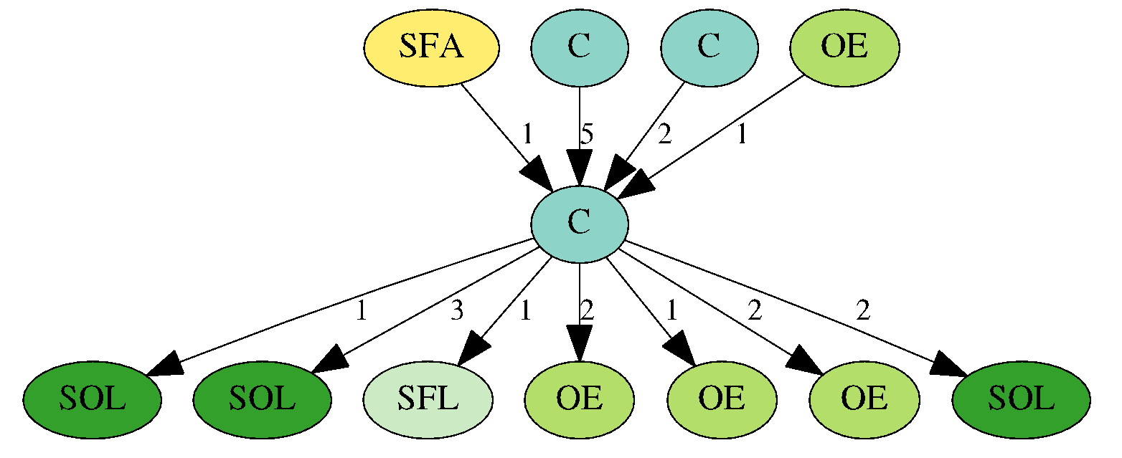
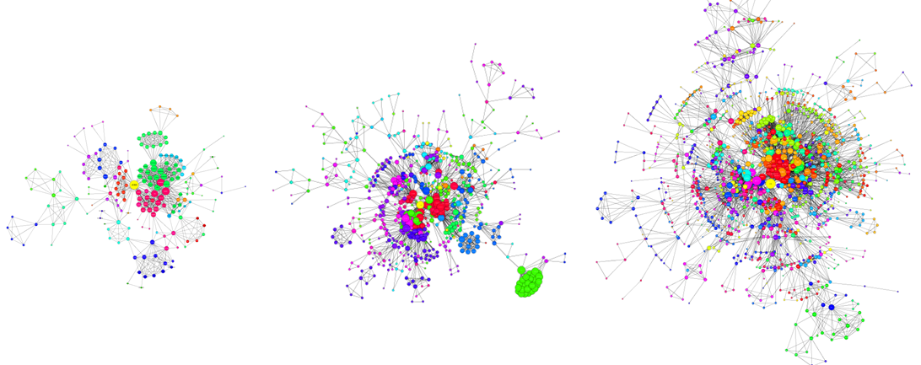
Graph Anomalies -II
Finding unusual graphs in a (unordered) set,
Graph database: e.g., transactions, software
or series of graphs
Dynamic graphs:
time
Notes:
What is this area about

Slide 5
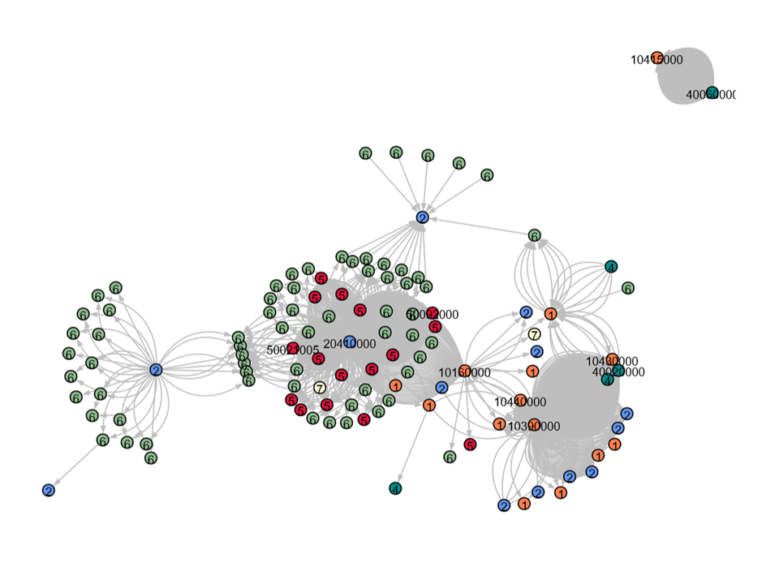
Graph Anomalies - Challenges
Graphs are complex objects
10-days’ transactions graph:
Notes:
Directed edges, multi-edges, weighted-edges, node labels, graph-level features
In other cases: multi-attributed nodes/edges, timestamps, …

Slide 6
Graph Anomalies - Challenges
Graphs are complex objects
relational, long-range dependencies
attributes
node, edge (e.g. type, timestamp), or graph-level
directed, weighted, and/or multi-edges
Lack of labels or universal loss functions
Scale, Adversaries, Explanations, …
Problem formulation
What is an anomaly?

Slide 7
Survey article
Graph-based Anomaly Detection and Description: A Survey. Leman Akoglu, Hanghang Tong, Danai Koutra Data Mining and Knowledge Discovery (DAMI), 29 (3), May 2015.
Static & Dynamic; Plain & Attributed
Explanation & Sense-making
Applications
Since ~2014: graph neural networks & deep learning

Slide 8
Roadmap
Introduction – Motivation
OddBall : spotting unusual nodes
Last 10 years
Graph Anomalies: Node-, Subgraph-, Graph-level
Graph Representation
Future

Slide 9
Settings & Graphs
Set up | Method | Directed edges {Y, N} | Weightededges {Y, N} | Multi-edges {Y, N} | Edge Attr. {Y, N} | Node Attr. {Y, N} | Time stmp. {Y, N}
N O D E | OddBall | 0 | 1 | 0 | 0 | 0 | 0
 | FraudEagle | 0 | 0 | 0 | 1 | 0 | 0
 | Speagle | 0 | 0 | 0 | 1 | 0.5 | 0
 | FocusCO | 0 | 0 | 0 | 0 | 1 | 0
S U B Gr | Fraudar | 0 | 0 | 0 | 0.5 | 0.5 | 0
 | CopyCatch | 0 | 0 | 0 | 0 | 0 | 1
 | AMEN | 0 | 0 | 0 | 0 | 1 | 0
G R A P H | StreamSpot | 0 | 0 | 0 | 0.5 | 0.5 | 1
 | SpotLight | 1 | 0 | 0 | 0 | 0 | 1
 | ChangeDAR | 0 | 0 | 0 | 1 | 1 | 1
 | CODEtect | 1 | 0 | 1 | 0 | 0.5 | 0

Slide 10
Outline
Graph Anomalies
Classes of problems
Node-level
Subgraph-level
Graph-level
Feature-based
Density-based
Similarity-based
Main ideas
Proximity-based
Community-based
Subgraph-based
Community-based
Compression-based

Slide 11
Node-level Anomalies
Problem:
Given a (plain or attributed) graph
Find unusual/rare nodes
Main ideas:
Feature-based (transforms to outlier detection)
Proximity-based (exploits assortativity)
Community-based (finds “misfits”)
Notes:
Misfits: nodes/edges outside the communities – bridges , or community outliers that do not fit (usually uses attributes)

Slide 12
Node-level Anomalies: Key ideas
Feature-based
Akoglu L, McGlohon M, Faloutsos C (PAKDD 2010) OddBall: spotting anomalies in weighted graphs.
Henderson K, Gallagher B, Li L, Akoglu L, Eliassi-Rad T, Tong H, Faloutsos C (KDD 2011) Graph mining using recursive structural features
Proximity-based
Chau DH, Pandit S, Faloutsos C (PKDD 2006) Detecting fraudulent personalities in networks of online auctioneers.
Community-based
Tong H, Lin C-Y (SDM 2011) Non-negative residual matrix factorization with application to graph anomaly detection.
Aggarwal CC, Zhao Y, Yu PS (ICDE 2011) Outlier detection in graph streams.
Gao J, Liang F, Fan W, Wang C, Sun Y, Han J (KDD 2010) On community outliers and their efficient detection in information networks.

Slide 13
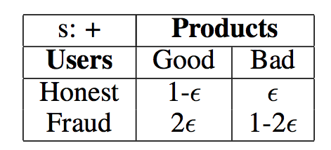






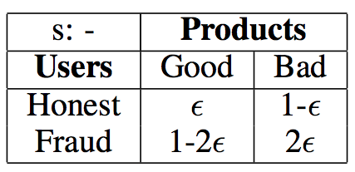




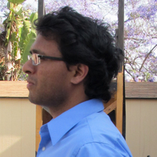

FraudEagle: Anomalous nodes in signed graphs
Node-level, Proximity-based
Fake reviewers, with limited supervision
User Product
Honest Bad
Honest Bad
Label propagation for inference
–
+
Opinion Fraud Detection in Online Reviews using Network Effects.
Leman Akoglu, Rishi Chandy, Christos Faloutsos ICWSM, 2013.

Slide 14
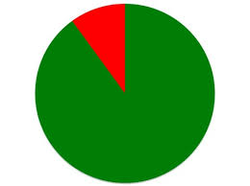
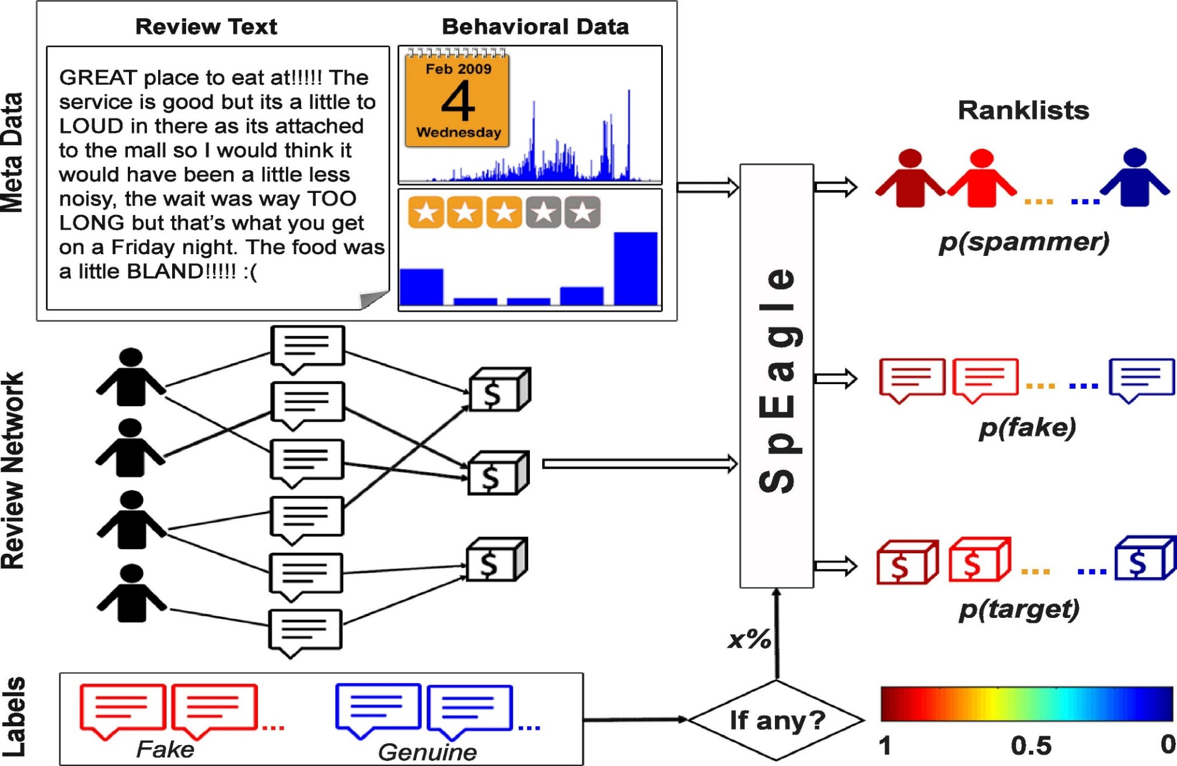

SpEagle: Anomalies in attributed graphs
Node-level, Proximity-based
Attributes mapped to a (single) prior score
‘benign’ ‘malicious’
Collective Opinion Spam Detection: Bridging Review Networks and Metadata. Shebuti Rayana, Leman Akoglu, KDD 2015.

Slide 15
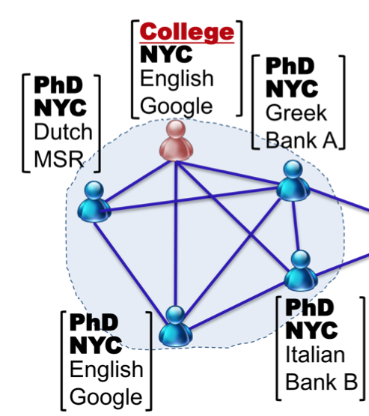



Node-level, Community-based
FocusCO: Anomalies in attributed graphs
Given examples of nodes user considers similar;
e.g. ‘Yann LeCun’&‘Foster Provost’
We learn a “focus”
Education Level: PhD
Location: NYC
Extract “focused” clusters
Detect cluster-outliers
Nodes that don’t agree with “focus”
Focused Clustering and Outlier Detection in Large Attributed Graphs. Bryan Perozzi, Leman Akoglu, Patricia Iglesias Sanchez, Emmanuel Müller. KDD 2014

Slide 16
Outline
Graph Anomalies
Classes of problems
Node-level
Subgraph-level
Graph-level
Feature-based
Density-based
Similarity-based
Main ideas
Proximity-based
Community-based
Subgraph-based
Community-based
Compression-based

Slide 17
Subgraph-level Anomalies
Problem:
Given a (plain or attributed) graph
Find unusual groups of nodes
Main ideas:
Density-based (significantly denser subgraphs)
Community-based (non-thematic groups)

Slide 18
Subgraph-level Anomalies: Key ideas
Density-based
Hooi, B., Song, H. A., Beutel, A., Shah, N., Shin, K., & Faloutsos, C. (KDD 2016). Fraudar: Bounding graph fraud in the face of camouflage.
Beutel, A., Xu, W., Guruswami, V., Palow, C., & Faloutsos, C. (WWW 2013). Copycatch: stopping group attacks by spotting lockstep behavior in social networks.
Prakash, B. A., Sridharan, A., Seshadri, M., Machiraju, S., & Faloutsos, C. (PAKDD 2010). Eigenspokes: Surprising patterns and scalable community chipping in large graphs.
Community-based
Perozzi, B., & Akoglu, L. (SDM 2016). Scalable anomaly ranking of attributed neighborhoods.
Gupta, M., Mallya, A., Roy, S., Cho, J. H., & Han, J. (SDM 2014). Local learning for mining outlier subgraphs from network datasets.

Slide 19
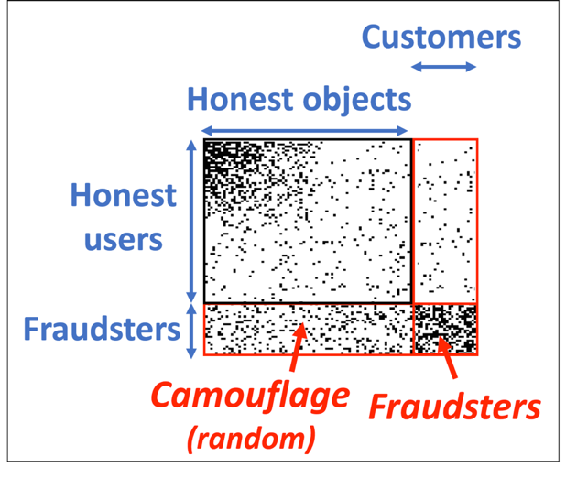
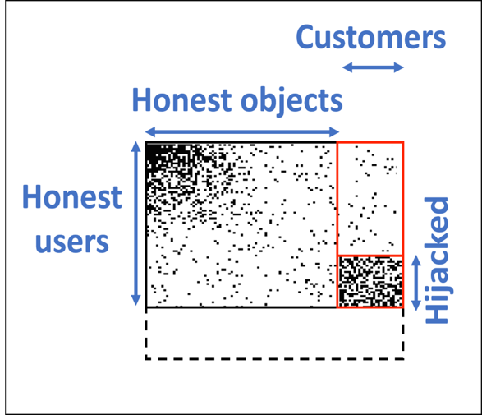


Fraudar: Camouflaged dense subgraphs
Subgraph-level, Density-based
“Lemons”
“Lemons”
Random camouflage
Hijacking
FRAUDAR: Bounding Graph Fraud in the Face of Camouflage. Bryan Hooi, Hyun Ah Song, Alex Beutel, Neil Shah, Kijung Shin, and Christos Faloutsos. KDD 2016

Slide 20

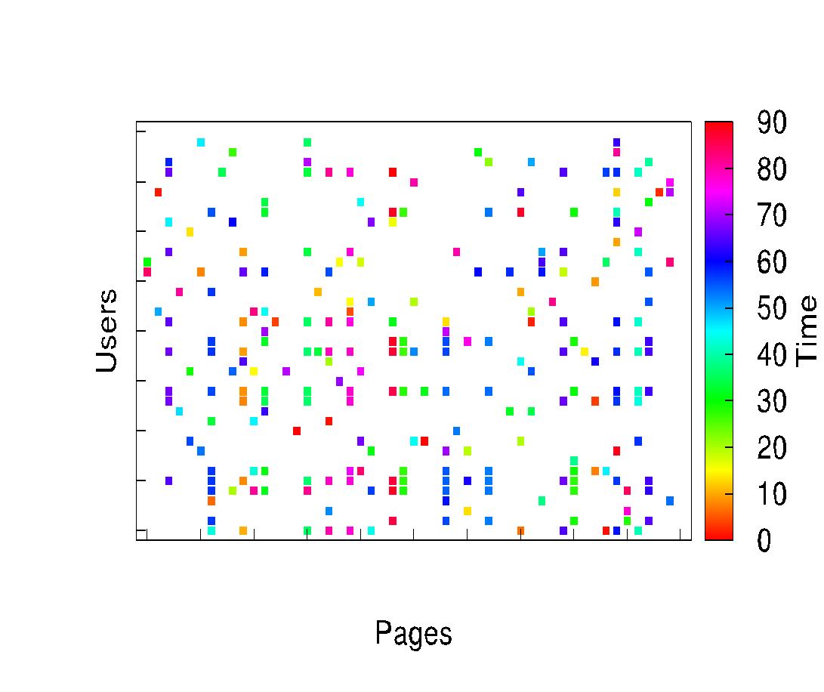
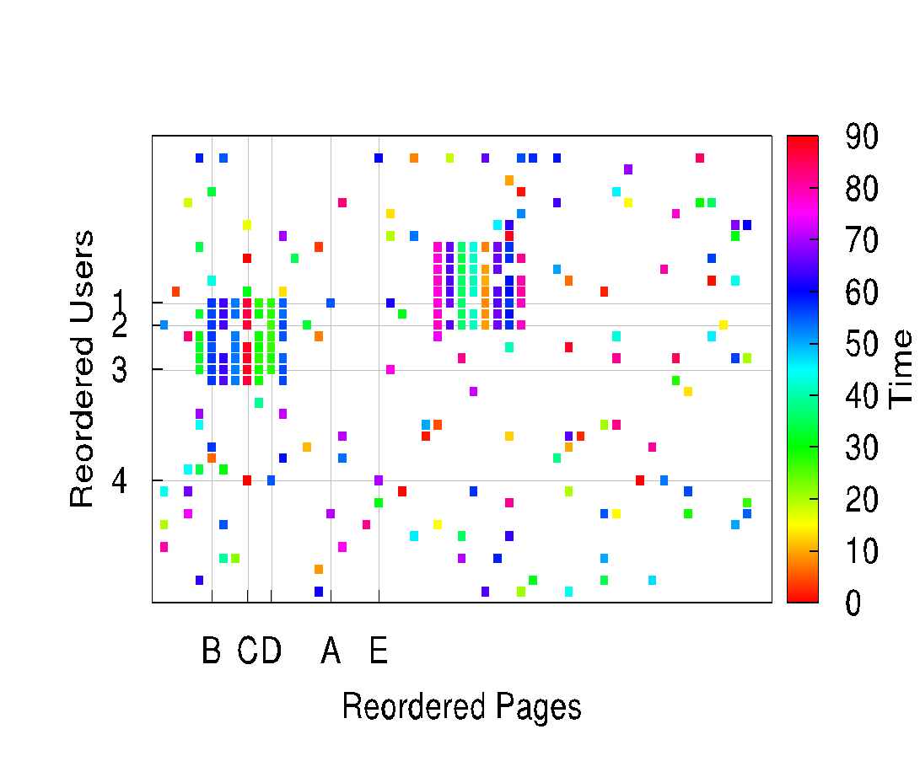


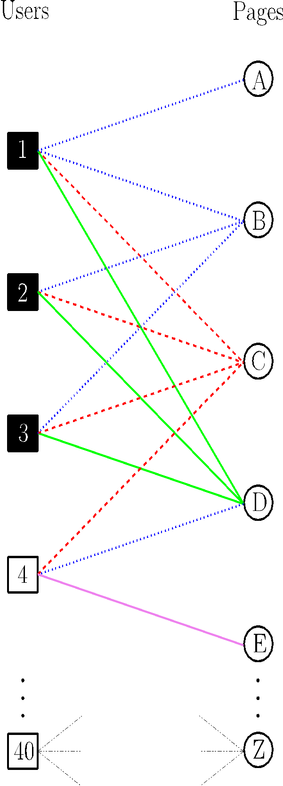










CopyCatch: Spotting group attacks
Subgraph-level, Density-based
Lockstep behavior: same targets, same time
Likes
Suspicious Lockstep Behavior
CopyCatch: stopping group attacks by spotting lockstep behavior in social networks. Alex Beutel, Wanhong Xu, Venkatesan Guruswami, Christopher Palow, Christos Faloutsos. WWW 2013.

Slide 21
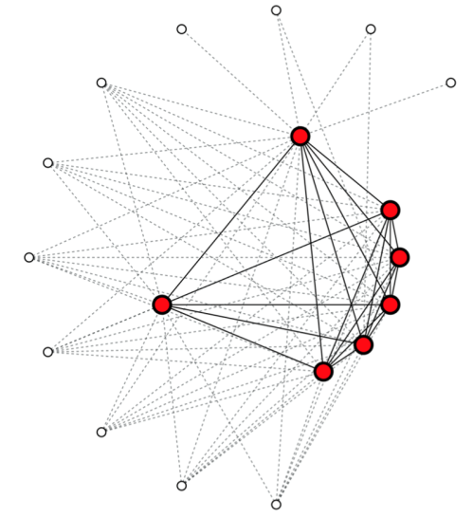
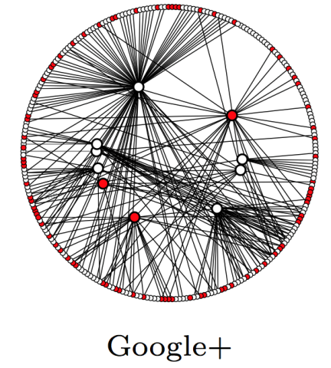
AMEN: Anomalous attributed subgraphs
Subgraph-level, Community-based
Subgraph-level
Given an attributed subgraph how to quantify “normality”?
Internal
structural density AND
attribute coherence = “focus”
Boundary
structural sparsity, OR
different “focus”
high
low
Scalable Anomaly Ranking of Attributed Neighborhoods. Bryan Perozzi & Leman Akoglu. SIAM SDM 2016

Slide 22
Outline
Graph Anomalies
Classes of problems
Node-level
Subgraph-level
Graph-level
Feature-based
Density-based
Similarity-based
Main ideas
Proximity-based
Community-based
Subgraph-based
Community-based
Compression-based

Slide 23
Graph-level Anomalies
Problem:
Given a set or sequence of (plain or attributed) graphs
Find unusual graphs
Main ideas:
Similarity-based (graph-level features, kernels)
Subgraph-based ([emergence of] rare subgraphs)
Compression-based (frequent motifs)

Slide 24
Graph-level Anomalies: Key ideas
Similarity-based
Lots of work on graph similarity. Focus: streaming graph representation
Manzoor, E., Milajerdi, S. M., & Akoglu, L. (KDD 2016). Fast memory-efficient anomaly detection in streaming heterogeneous graphs.
Subgraph-based
Eswaran, D., Faloutsos, C., Guha, S., & Mishra, N. (KDD 2018). Spotlight: Detecting anomalies in streaming graphs.
Hooi, B., Akoglu, L., Eswaran, D., Pandey, A., Jereminov, M., Pileggi, L., & Faloutsos, C. (CIKM 2018). Changedar: Online localized change detection for sensor data on a graph..
Compression-based
Noble C. C., Cook D. J. (KDD 2003) Graph-based anomaly detection.
Sun, J., Faloutsos, C., Papadimitriou, S., & Yu, P. S. (KDD 2007). Graphscope: parameter-free mining of large time-evolving graphs.
Nguyen, H. T., Liang, P. J., & Akoglu, L. (arXiv preprint arXiv:2010.03600 2020). Anomaly Detection in Large Labeled Multi-Graph Databases.

Slide 25
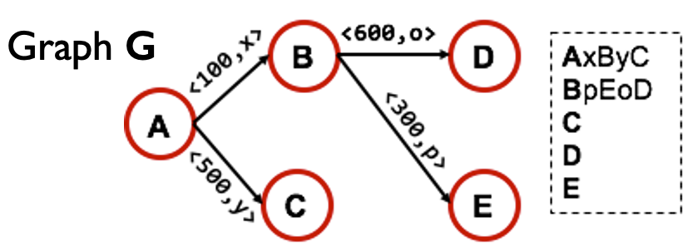
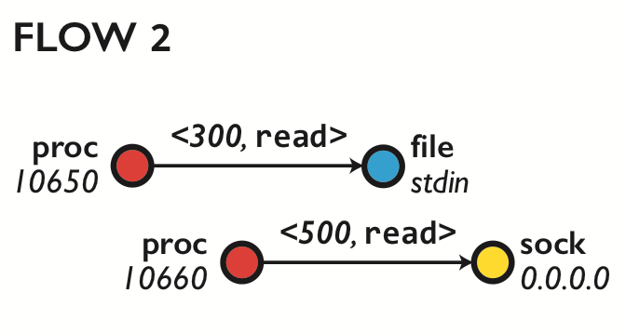
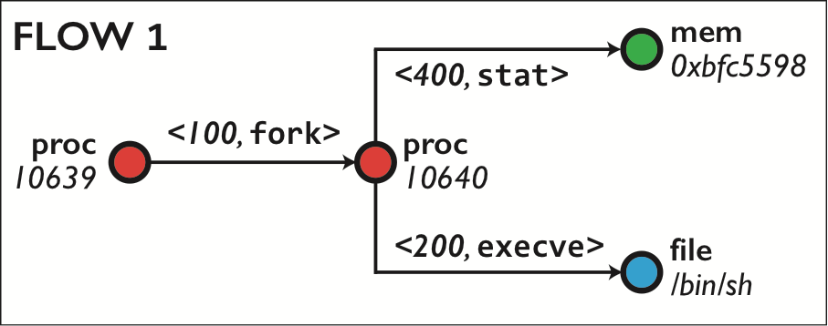
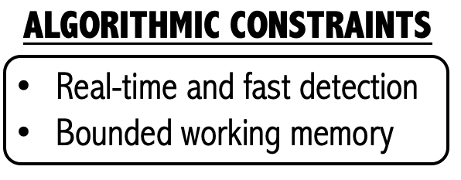


StreamSpot: Anomalies in Streaming Heterogeneous graphs
Graph-level, Similarity-based
Command-flow graphs
Fast Memory-Efficient Anomaly Detection in Streaming Heterogeneous Graphs. Emaad A. Manzoor, Sadegh M. Milajerdi, Leman Akoglu. KDD 2016

Slide 26
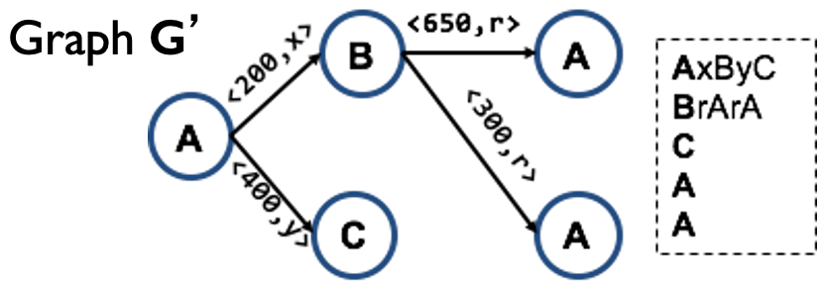
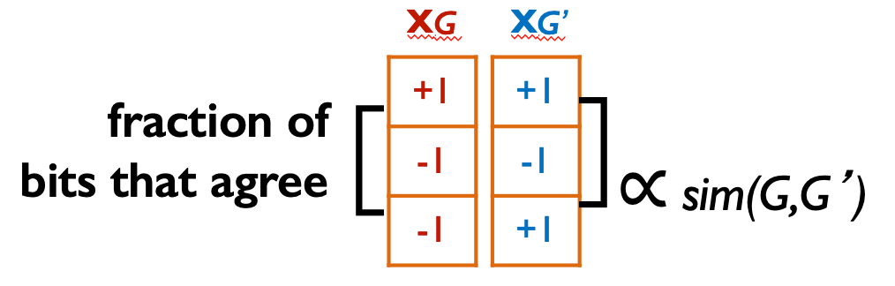
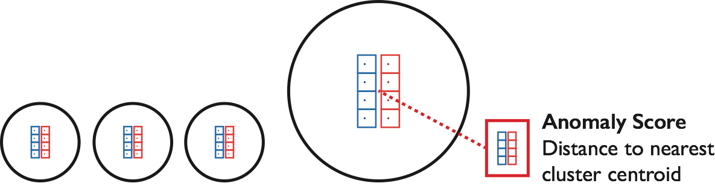
StreamSpot: Anomalies in Streaming Heterogeneous graphs
Graph-level, Similarity-based
Graph similarity via “k-shingle” frequencies
Streaming & bounded representation
Clustering-based
Anomaly Detection
Fast Memory-Efficient Anomaly Detection in Streaming Heterogeneous Graphs. Emaad A. Manzoor, Sadegh M. Milajerdi, Leman Akoglu. KDD 2016

Slide 27
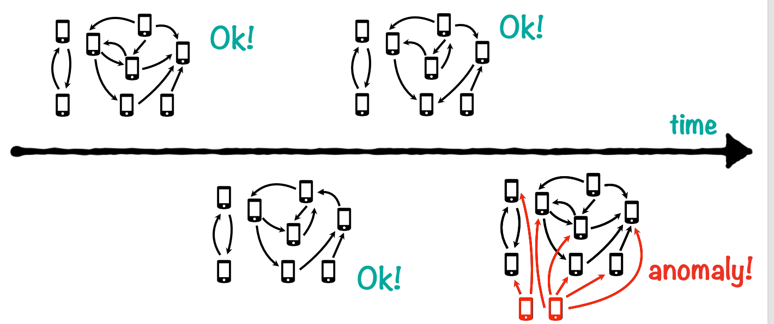
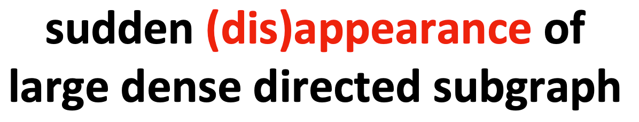
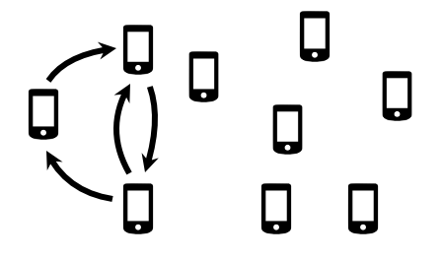


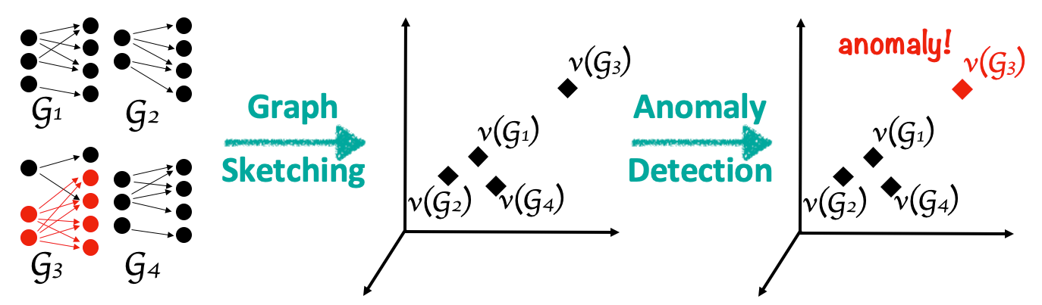




SpotLight: Anomalies in Streaming Graphs
Graph-level, Subgraph-based
SpotLight: Detecting Anomalies in Streaming Graphs. Dhivya Eswaran, Christos Faloutsos, Sudipto Guha, Nina Mishra. KDD 2018.

Slide 28
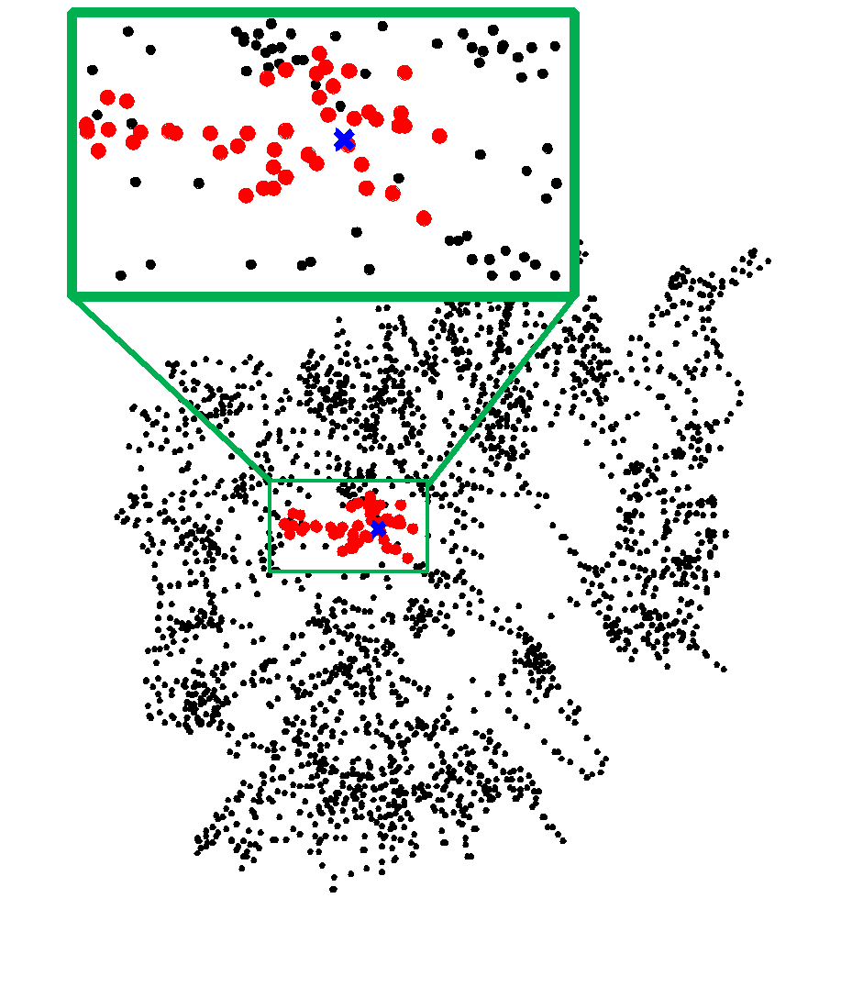
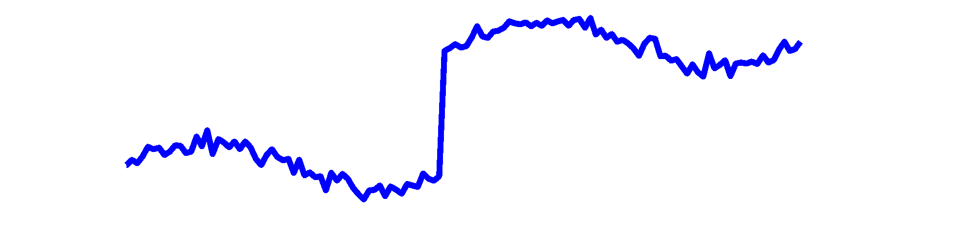


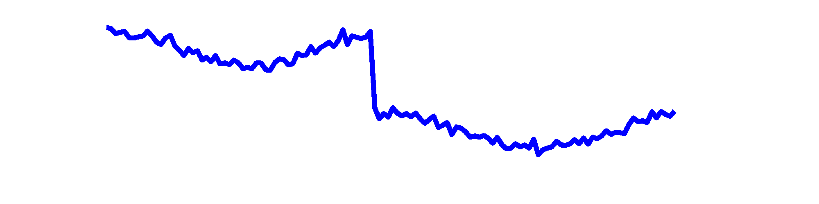

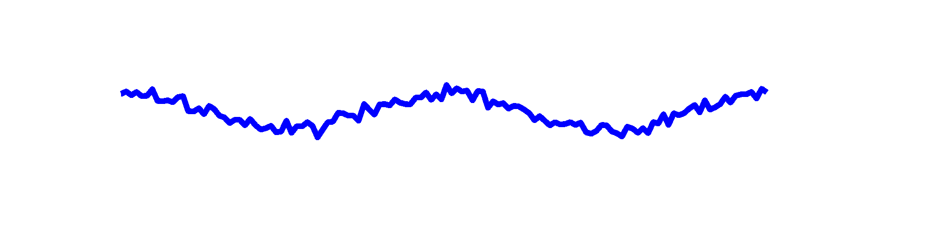
ChangeDAR: Localized Change Detection
Graph-level, Subgraph-based
High Voltage Network
t
S
Online Localized Change Detection for Sensor Data on a Graph. Bryan Hooi, Leman Akoglu, Dhivya Eswaran, Hyun Ah Song, Amritanshu Pandey, Marko Jereminov, Larry Pileggi, Christos Faloutsos. CIKM 2018

Slide 29
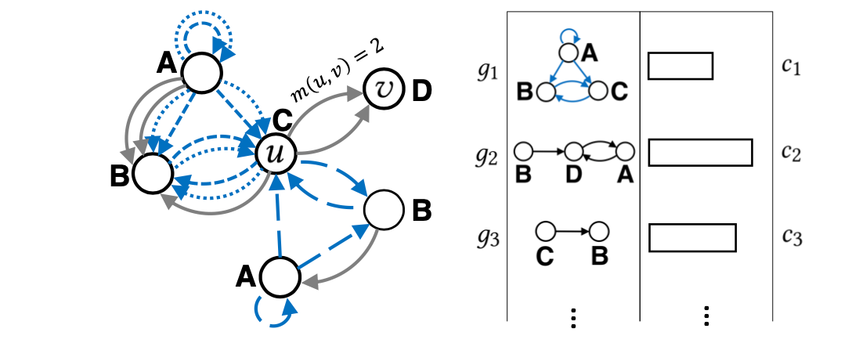






CODEtect: Labeled Multi-graph Anomalies
Graph-level, Compression-based
Anomaly detection by data compression
Anomaly Detection in Labeled Multi-Graph Databases. Hung Nguyen, Pierre J. Liang, Leman Akoglu https://arxiv.org/abs/2009.10606, 2020

Slide 30

CODEtect: Labeled Multi-graph Anomalies
Graph-level, Compression-based
Anomaly detection by data compression
Anomaly Detection in Labeled Multi-Graph Databases. Hung Nguyen, Pierre J. Liang, Leman Akoglu https://arxiv.org/abs/2009.10606, 2020

Slide 31
Roadmap
Introduction – Motivation
OddBall : spotting unusual nodes
Last 10 years
Graph Anomalies: Node-, Subgraph-, Graph-level
Graph Representation
Future

Slide 32
Graph Anomalies - Challenges
Graphs are complex objects
10-days’ transactions graph:
Notes:
Directed edges, multi-edges, weighted-edges, node labels, graph-level features
In other cases: multi-attributed nodes/edges, timestamps, …

Slide 33
Settings & Graphs
Set up | Method | Directed {Y, N} | Weighted {Y, N} | Multi-edges {Y, N} | Edge Attr. {Y, N} | Node Attr. {Y, N} | Time {Y, N}
N O D E | OddBall | 0 | 1 | 0 | 0 | 0 | 0
 | FraudEagle | 0 | 0 | 0 | 1 | 0 | 0
 | Speagle | 0 | 0 | 0 | 1 | 0.5 | 0
 | FocusCO | 0 | 0 | 0 | 0 | 1 | 0
S U B Gr. | Fraudar | 0 | 0 | 0 | 0.5 | 0.5 | 0
 | CopyCatch | 0 | 0 | 0 | 0 | 0 | 1
 | AMEN | 0 | 0 | 0 | 0 | 1 | 0
G R A P H | StreamSpot | 0 | 0 | 0 | 0.5 | 0.5 | 1
 | SpotLight | 1 | 0 | 0 | 0 | 0 | 1
 | ChangeDAR | 0 | 0 | 0 | 1 | 1 | 1
 | CODEtect | 1 | 0 | 1 | 0 | 0.5 | 0

Slide 34






Recent Trend: GNNs
Graph neural networks (GNNs) can
automatically learn (vector) representations

Slide 35
Recent Trend: GNNs
Graph neural networks (GNNs) can
automatically learn (vector) representations
readily handle various properties: labeled/ attributed nodes, directed, weighted edges
be trained end-to-end
GNN

Slide 36
Rep. Learning with GNNs
Node-level
[unsupervised] Perozzi, B., Al-Rfou, R., & Skiena, S. (KDD 2014). Deepwalk: Online learning of social representations.
[(un)supervised] Hamilton, W. L., Ying, R., & Leskovec, J. (NeurIPS 2017). Inductive representation learning on large graphs.
Graph-level
[unsupervised] Narayanan, A., Chandramohan, M., Venkatesan, R., Chen, L., Liu, Y., & Jaiswal, S. (2017). graph2vec: Learning distributed representations of graphs.
[supervised] Niepert, M., Ahmed, M., & Kutzkov, K. (PMLR, 2016). Learning convolutional neural networks for graphs.
[supervised] Xu, K., Hu, W., Leskovec, J., & Jegelka, S. (ICLR 2019). How powerful are graph neural networks?

Slide 37
Anomaly Detection with GNNs
Node-level
Yu, W., Cheng, W., Aggarwal, C. C., Zhang, K., Chen, H., & Wang, W. (KDD 2018). Netwalk: A flexible deep embedding approach for anomaly detection in dynamic networks.
Ding, K., Li, J., Bhanushali, R., & Liu, H. (SDM 2019). Deep anomaly detection on attributed networks.
Zhao, T., Deng, C., Yu, K., Jiang, T., Wang, D., & Jiang, M. (CIKM 2020). Error-Bounded Graph Anomaly Loss for GNNs.
Wang, X., Jin, B., Du, Y., Cui, P., & Yang, Y. (Neur. Comp. & Appl. 2021). One-Class Graph Neural Networks for Anomaly Detection in Attributed Networks.
Graph-level
Sawlani, S., Zhao, L., Akoglu, L. (2021). Deep Graph-level Anomaly Detection

Slide 38
Anomaly Detection with GNNs - Challenges
End-to-end training necessitates a loss
Reconstruction, one-class classification loss(es)
Learned rep.s not interpretable
cf. hand-crafted features, motifs, etc.
Model selection (!)
many hyperparameters, but no labels to tune

Slide 39


Conclusions & Take-aways
Graph anomalies find numerous applications
opinion fraud, host-level intrusion, environmental monitoring, accounting fraud, …
Graphs may have variety of properties
timestamps, node labels/attributes, and/or edge directions/weights/multiplicities/types
Problem formulation & key approach informed by
domain and available information
GNNs, a recent trend
need loss functions & model tuning
Anomalies: known vs. unknown
for the latter, need better pattern mining

Slide 40
Roadmap
Introduction – Motivation
OddBall : spotting unusual nodes
Last 10 years
Graph Anomalies
Graph Representation
Future

Slide 41


Thank you!

Slide 42
What is this area about
Classes of problems
How do people solve this? - clever ideas, sensible things one would try

